Slide 1
Does temporal evolution of gaze during decision making predict choice in alcoholic smokers?
James Wilmott
July 9, 2018

Slide 3
High preference substances:
substances of primary use
-e.g., Heineken and Marlboro
Low preference substances:
other brands/categories
- e.g., Budweiser/vodka and Newport

Slide 4
High preference substances:
substances of primary use
-e.g., Heineken and Marlboro
Low preference substances:
other brands/categories
- e.g., Budweiser/vodka and Newport
160 sequential trials across 4 blocks:
- 80 high preference trials
- 30 low cigarette, high alcohol trials
- 30 high cigarette, low alcohol trials
- 20 low preference trials

Slide 5
Notes:
Complex eye traces.
Is the temporal evolution of gaze priority (where you look) predictive of choice?

Slide 6
Temporal evolution of gaze
Is the temporal change in priority of gaze across trials predictive of choice?
Are there differences across trial types in the timing of choice prediction?
Notes:
Gaze preference = priority of gaze
What we want from this population is a better understanding of whether pathology associated with alcohol or cigarettes may be exhibited through gaze

Slide 7
Dependent measure: fixation likelihood
Trial n
[ 0 0 0 A A A A A 0 0 C C C C C C C C C C C 0 0 N N N N….... A]
Item
-985
-983
t
0
-997
-993
-991
-984
-980
-999
-992
-986
-977
-998
-982
-988
-981
-979
Time
-994
-990
-987
-978
-996
-989
-974
-995
-976
-1000
-975
Notes:
In a trial, identify which item is looked at for each time step
Restrict to 1000 time steps the mean reaction time across all participants is greater than that (~1200 ms), so it encompasses a majority of trials

Slide 8
Dependent measure: fixation likelihood
Alcohol
Subject i
[ 0 0 0 0 0.25 0.2 0.25 0.33 0.33 0.33 ….. 0.8]
[ 0 0 0 A A 0 0 C C C C C 0 0 N N….... A]
[N N N N 0 0 0 0 0 0 0 0 0 0 0 0 ….... C]
Cigarette
[A A A A A A A A A 0 0 0 C C C C ….... A]
[ 0 0 0 0 0.25 0.2 0.25 0.33 0.33 0.33 ….. 0.15]
[ 0 C C C C 0 0 A A A A C 0 0 N N….... A]
[- - - - - - - - - - - - - - - - - - A A A….... A]
Neutral
etc.
[ 0 0 0 0 0.25 0.2 0.25 0.33 0.33 0.33 ….. 0.05]
Notes:
Aggregation of trials: at each time point, sum number of instances of that object, then divide by number of trials (potential times could have looked at that item at that timestep)
Trials without a sample at timepoint t do not get counted for that timestep in aggregate accumulation
At some point, the liklihood of looking at each item will differ. When does this happen?

Slide 9
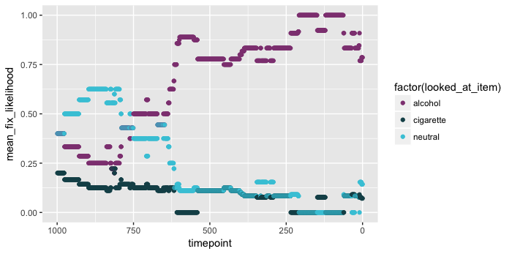
Subject 2, high preference, selected alcohol
Notes:
High preference, selected alcohol
Noisy, but seemingly there are trends
Individual subject is interesting, but what about whole-group level?

Slide 10
Mean fixation likelihood
Sample means
Subject i
Alcohol
[ 0 0 0 0 0.25 0.2 0.25 0.33 0.33 0.33 ….. 0.8]
Alcohol
Cigarette
[ 0.1 0.1 0.15 0.1 0.167….. 0.7]
[ 0 0 0 0 0.25 0.2 0.25 0.33 0.33 0.33 ….. 0.15]
Neutral
Cigarette
[ 0 0 0 0 0.25 0.2 0.25 0.33 0.33 0.33 ….. 0.05]
[0 0.05 0.0675 0.1 0.1 ….. 0.225]
Subject i+1
Neutral
etc.
[ 0 0 0 0 0.1 0.115 0.12 ….. 0.075]
Notes:
Care about the group-level
Have dependent measure (mean fixation likelihood), have categorical predictor, now need a statistic to determine significance of differences

Slide 11
Group level analysis
At each time point:
Mean fixation likelihood ~ Intercept + item + random effect of subject + error
Follow-up comparisons:
Alcohol – Cigarette
Alcohol – Neutral
Cigarette - Neutral
Notes:
Run this for each trial type, broken down by the selected item in that trial
[high preference, low cig high alc, high cig low alc, low preference]
Talk about stats with the CAAS statistician... need to synchronize dependent measures with CAAS

Slide 12
Both preferred substance trials

Slide 13
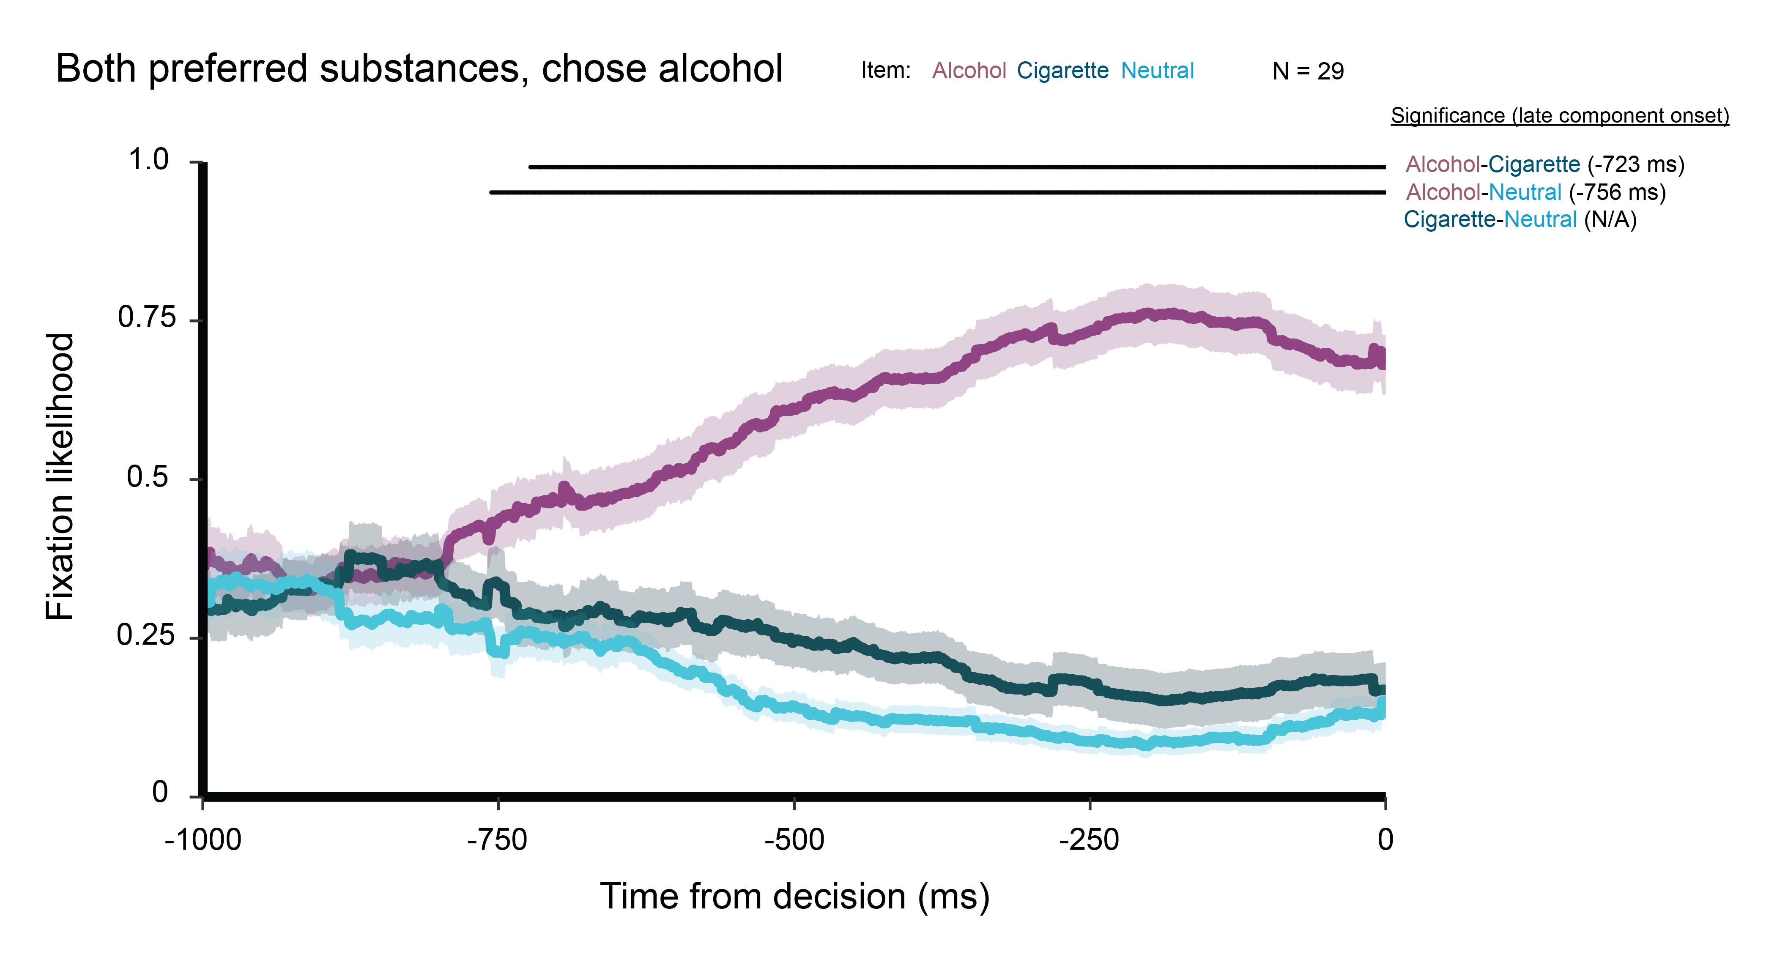

Slide 14
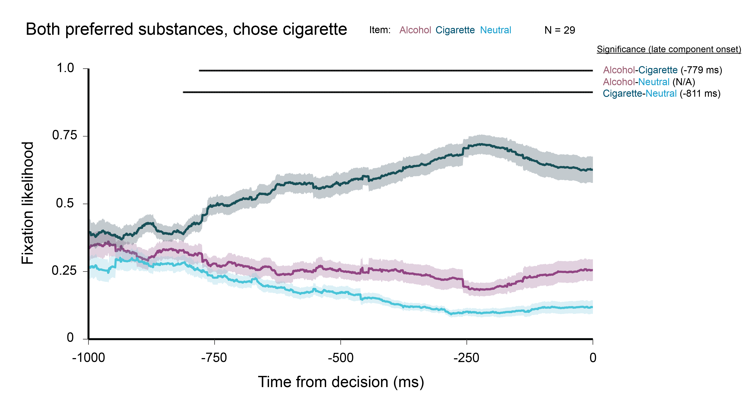
Notes:
Earlier onset than selected alcohol (~ 50 ms for each comparison)

Slide 15
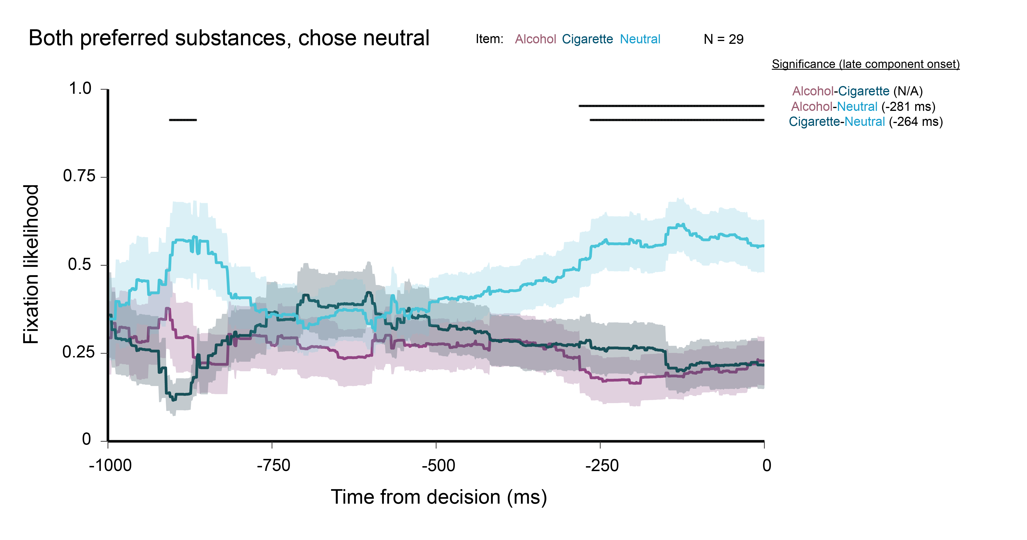
Notes:
Less trials here

Slide 16
Key takeaways
Chosen item more likely to be fixated late in trials
Positive slope for chosen item curve
Earlier onset of gaze priority when choosing alcohol or cigarette
Late onset much earlier for addictive substances than neutral
Cigarette may differentiate earlier than alcohol (earlier late component onset by ~50 ms)
Notes:
Might exemplify pathological prioritization of looking at alcohol.. (cravings?)
Great, you look at what you choose and it becomes stronger later in the trial. Does this same pattern exist in other types of trials?

Slide 17
High cigarette/low alcohol trials

Slide 18
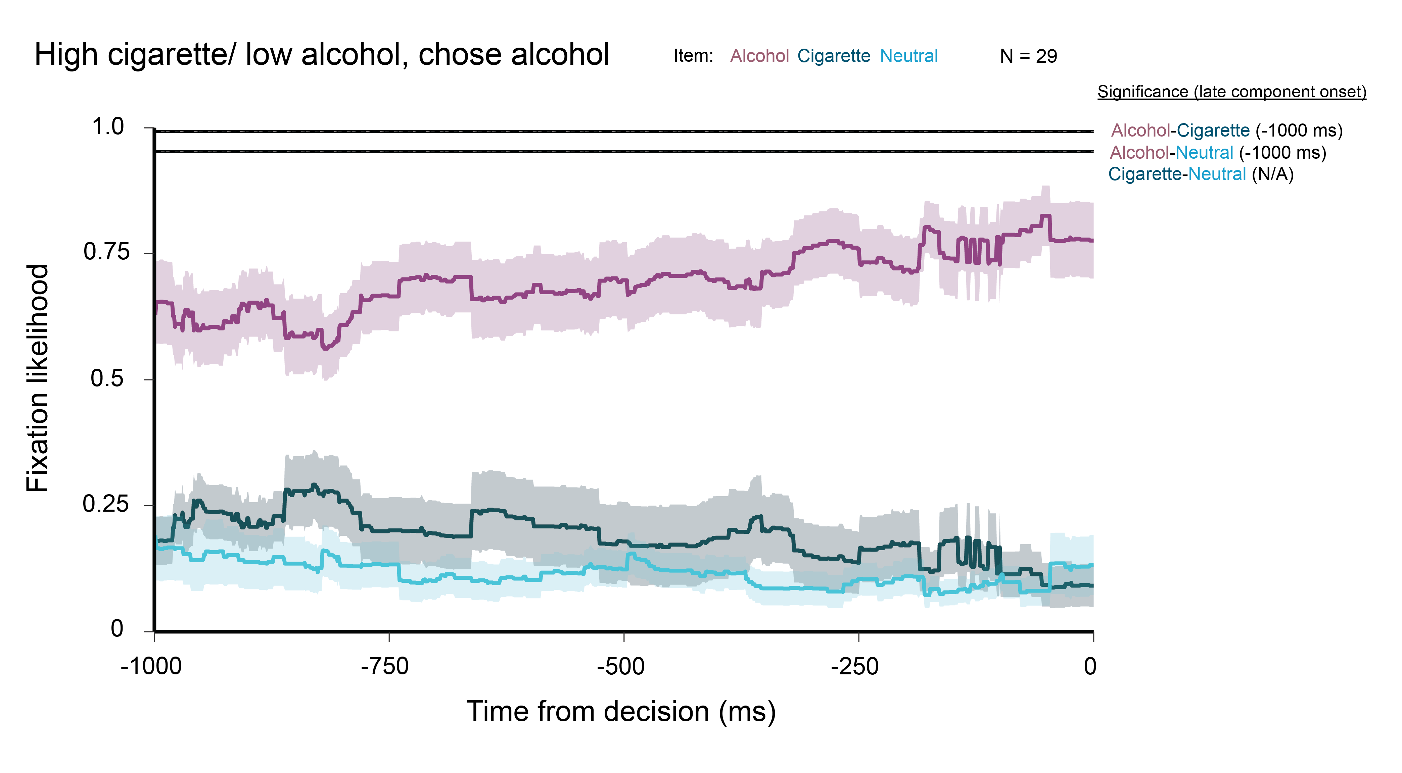
Notes:
Desensitized to cigarettes? Aggregating across many different items for alcohol but same cigarette item
Variance in value to alcohol > than cigarette? So we’re capturing more high-value alcohol here…?
Less chosen alcohol items than cigarette items

Slide 19
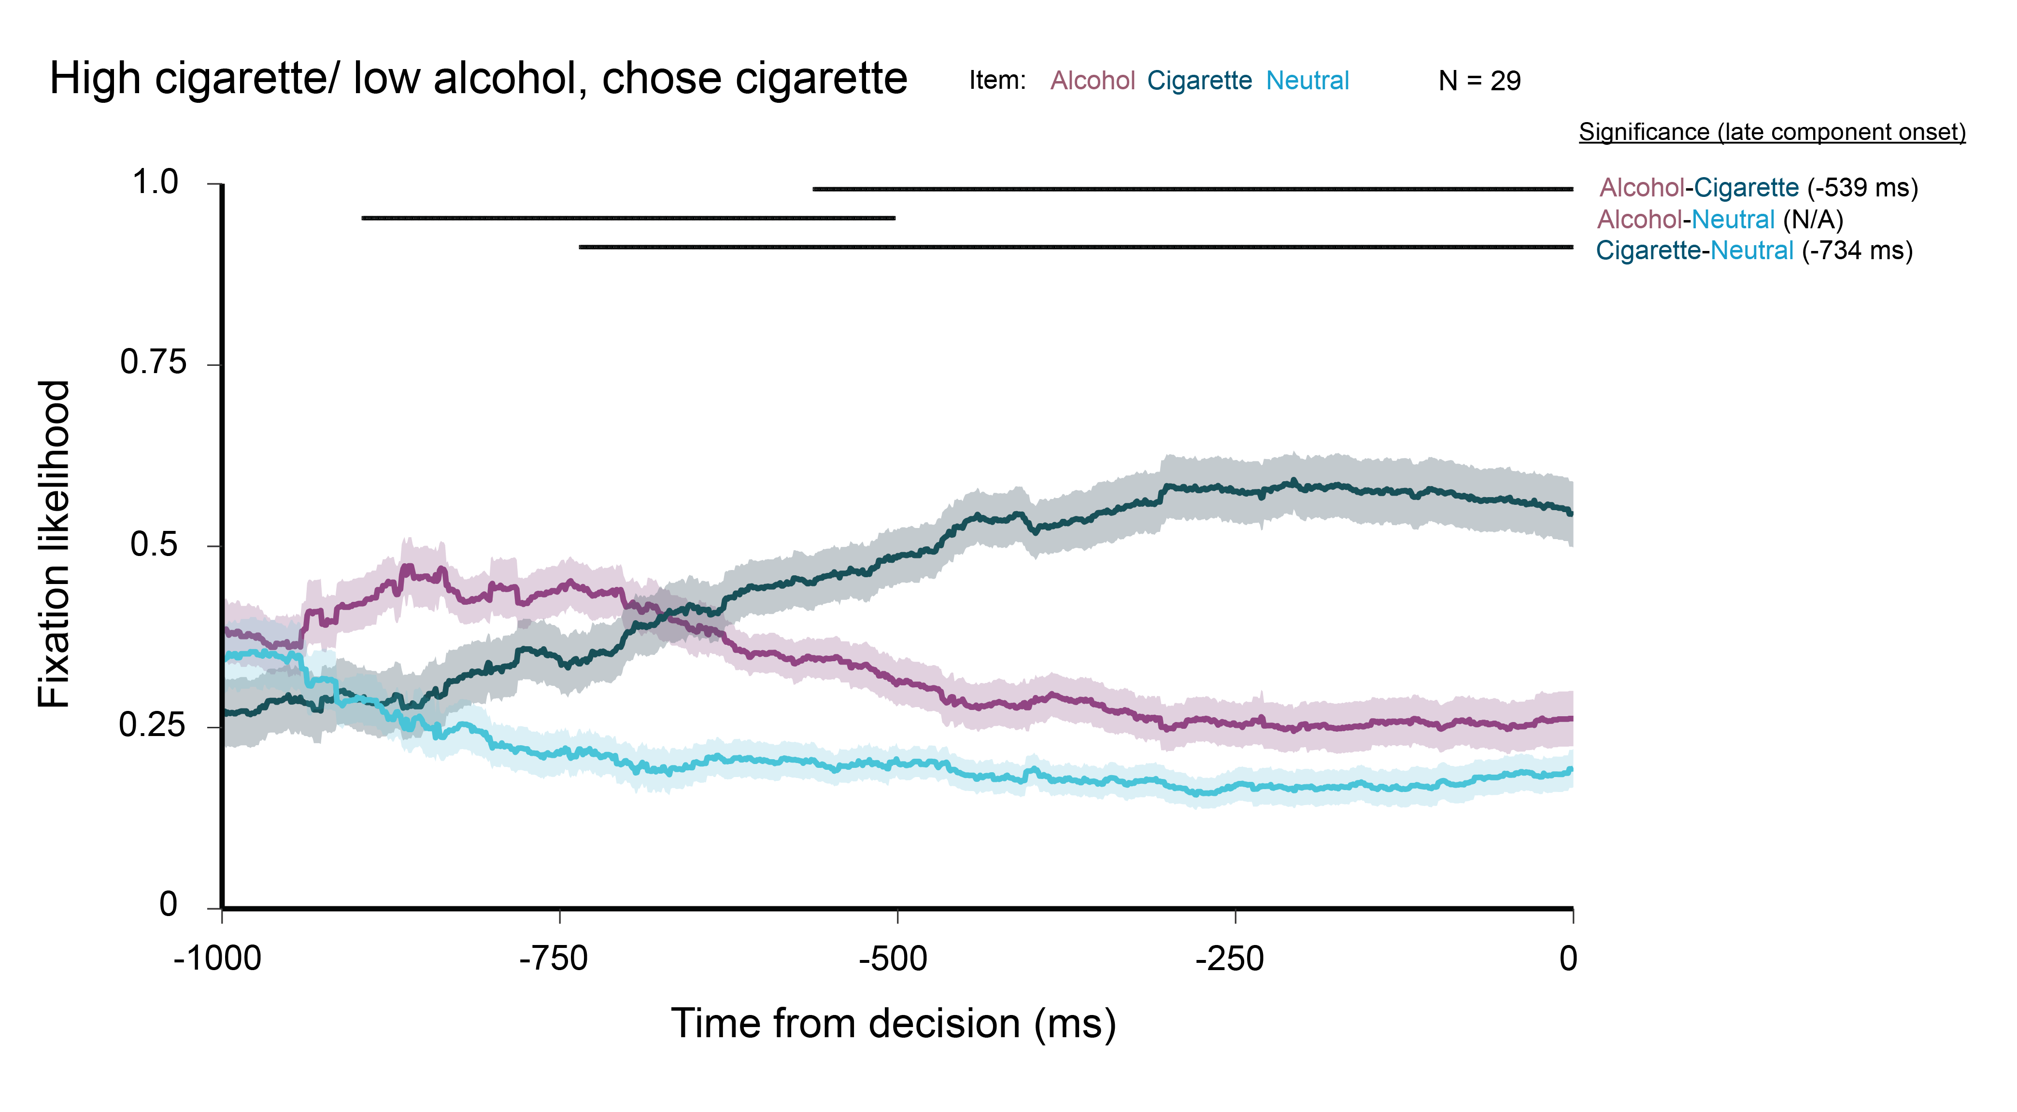
Notes:
Early component is sampling?

Slide 20
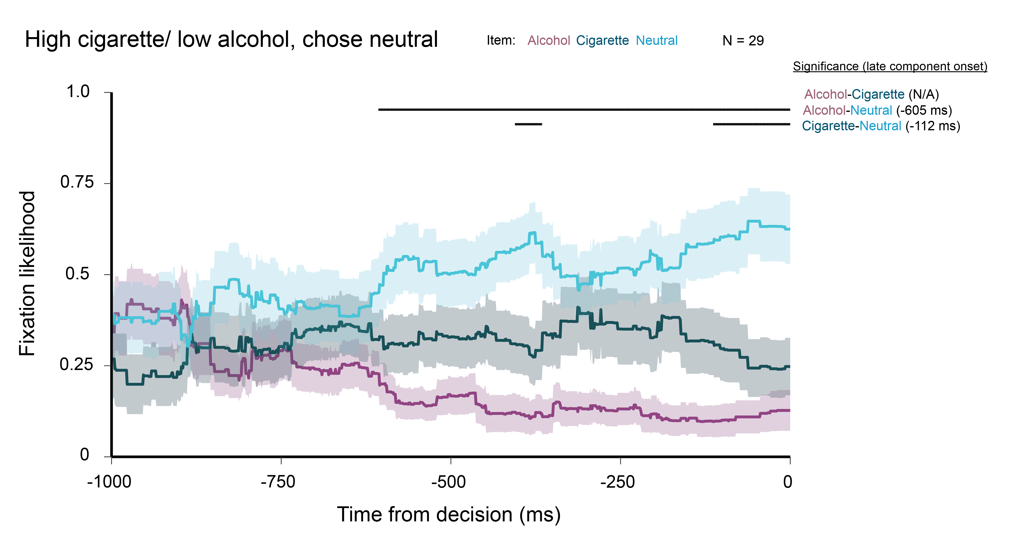
Notes:
More likely to look at cigarettes late on…

Slide 21
Key takeaways
Late period before decision predictive of choice
Positive slope for chosen item
Sampling of low-preference alcohol overrides gaze priority to high preference cigarette
Earlier onset when selecting alcohol
Early component when selecting cigarette indicate sampling

Slide 22
Low cigarette/ high alcohol trials

Slide 23
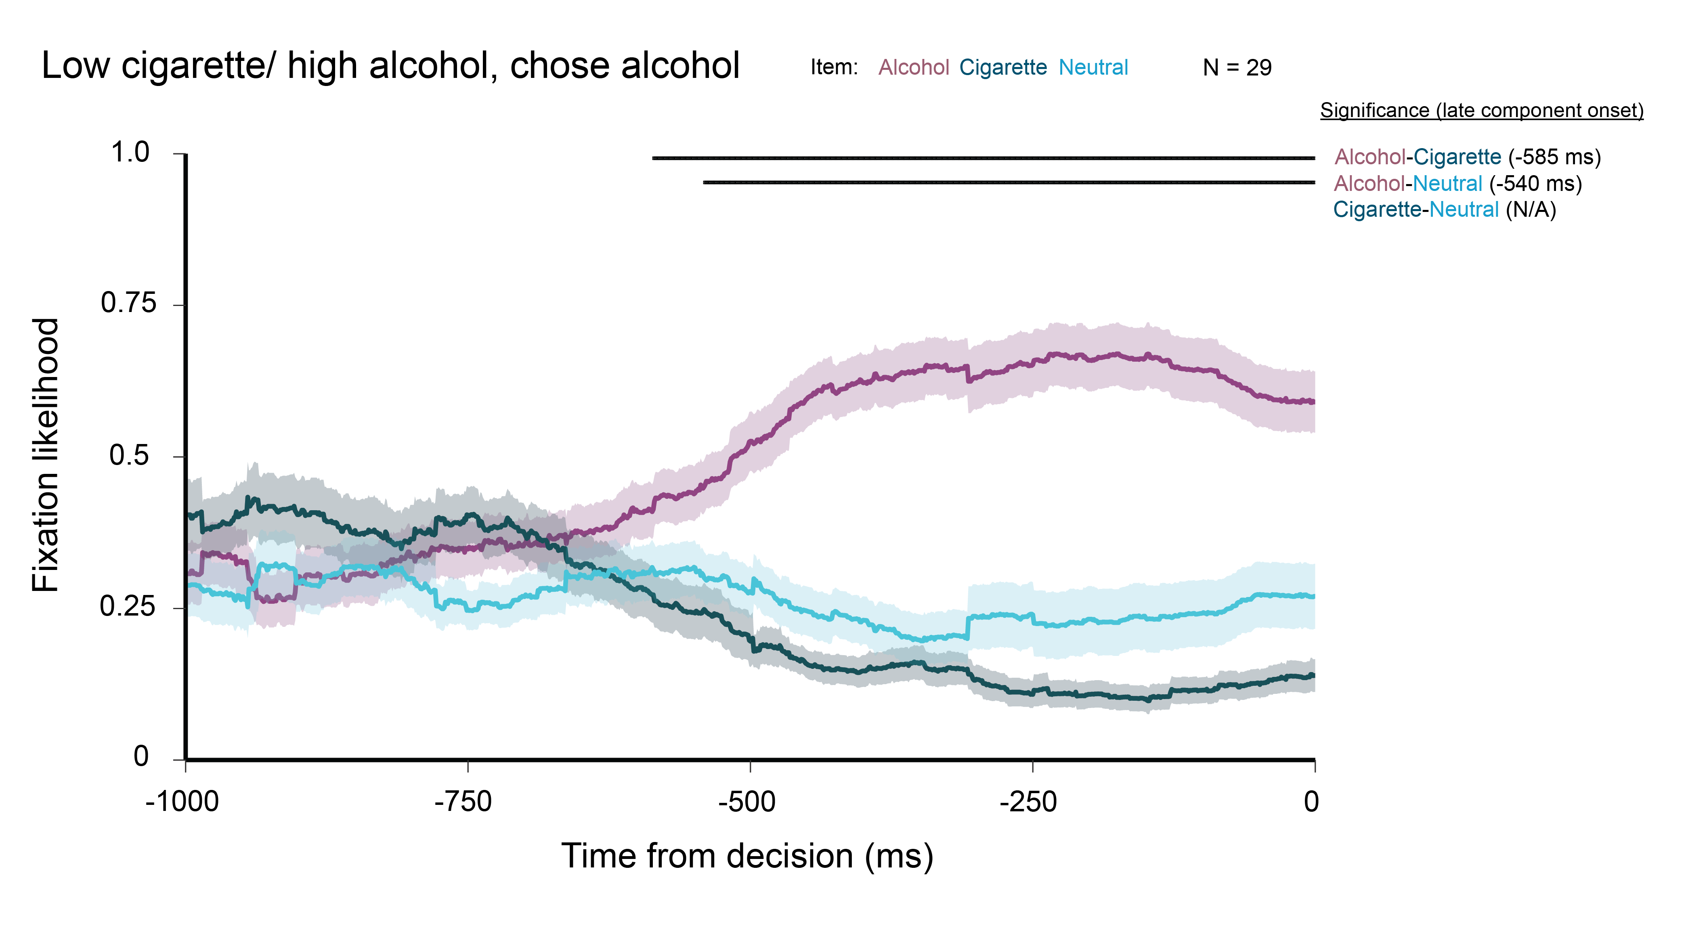
Notes:
About what we might expect, looks a lot like the both preferred substances trials

Slide 24
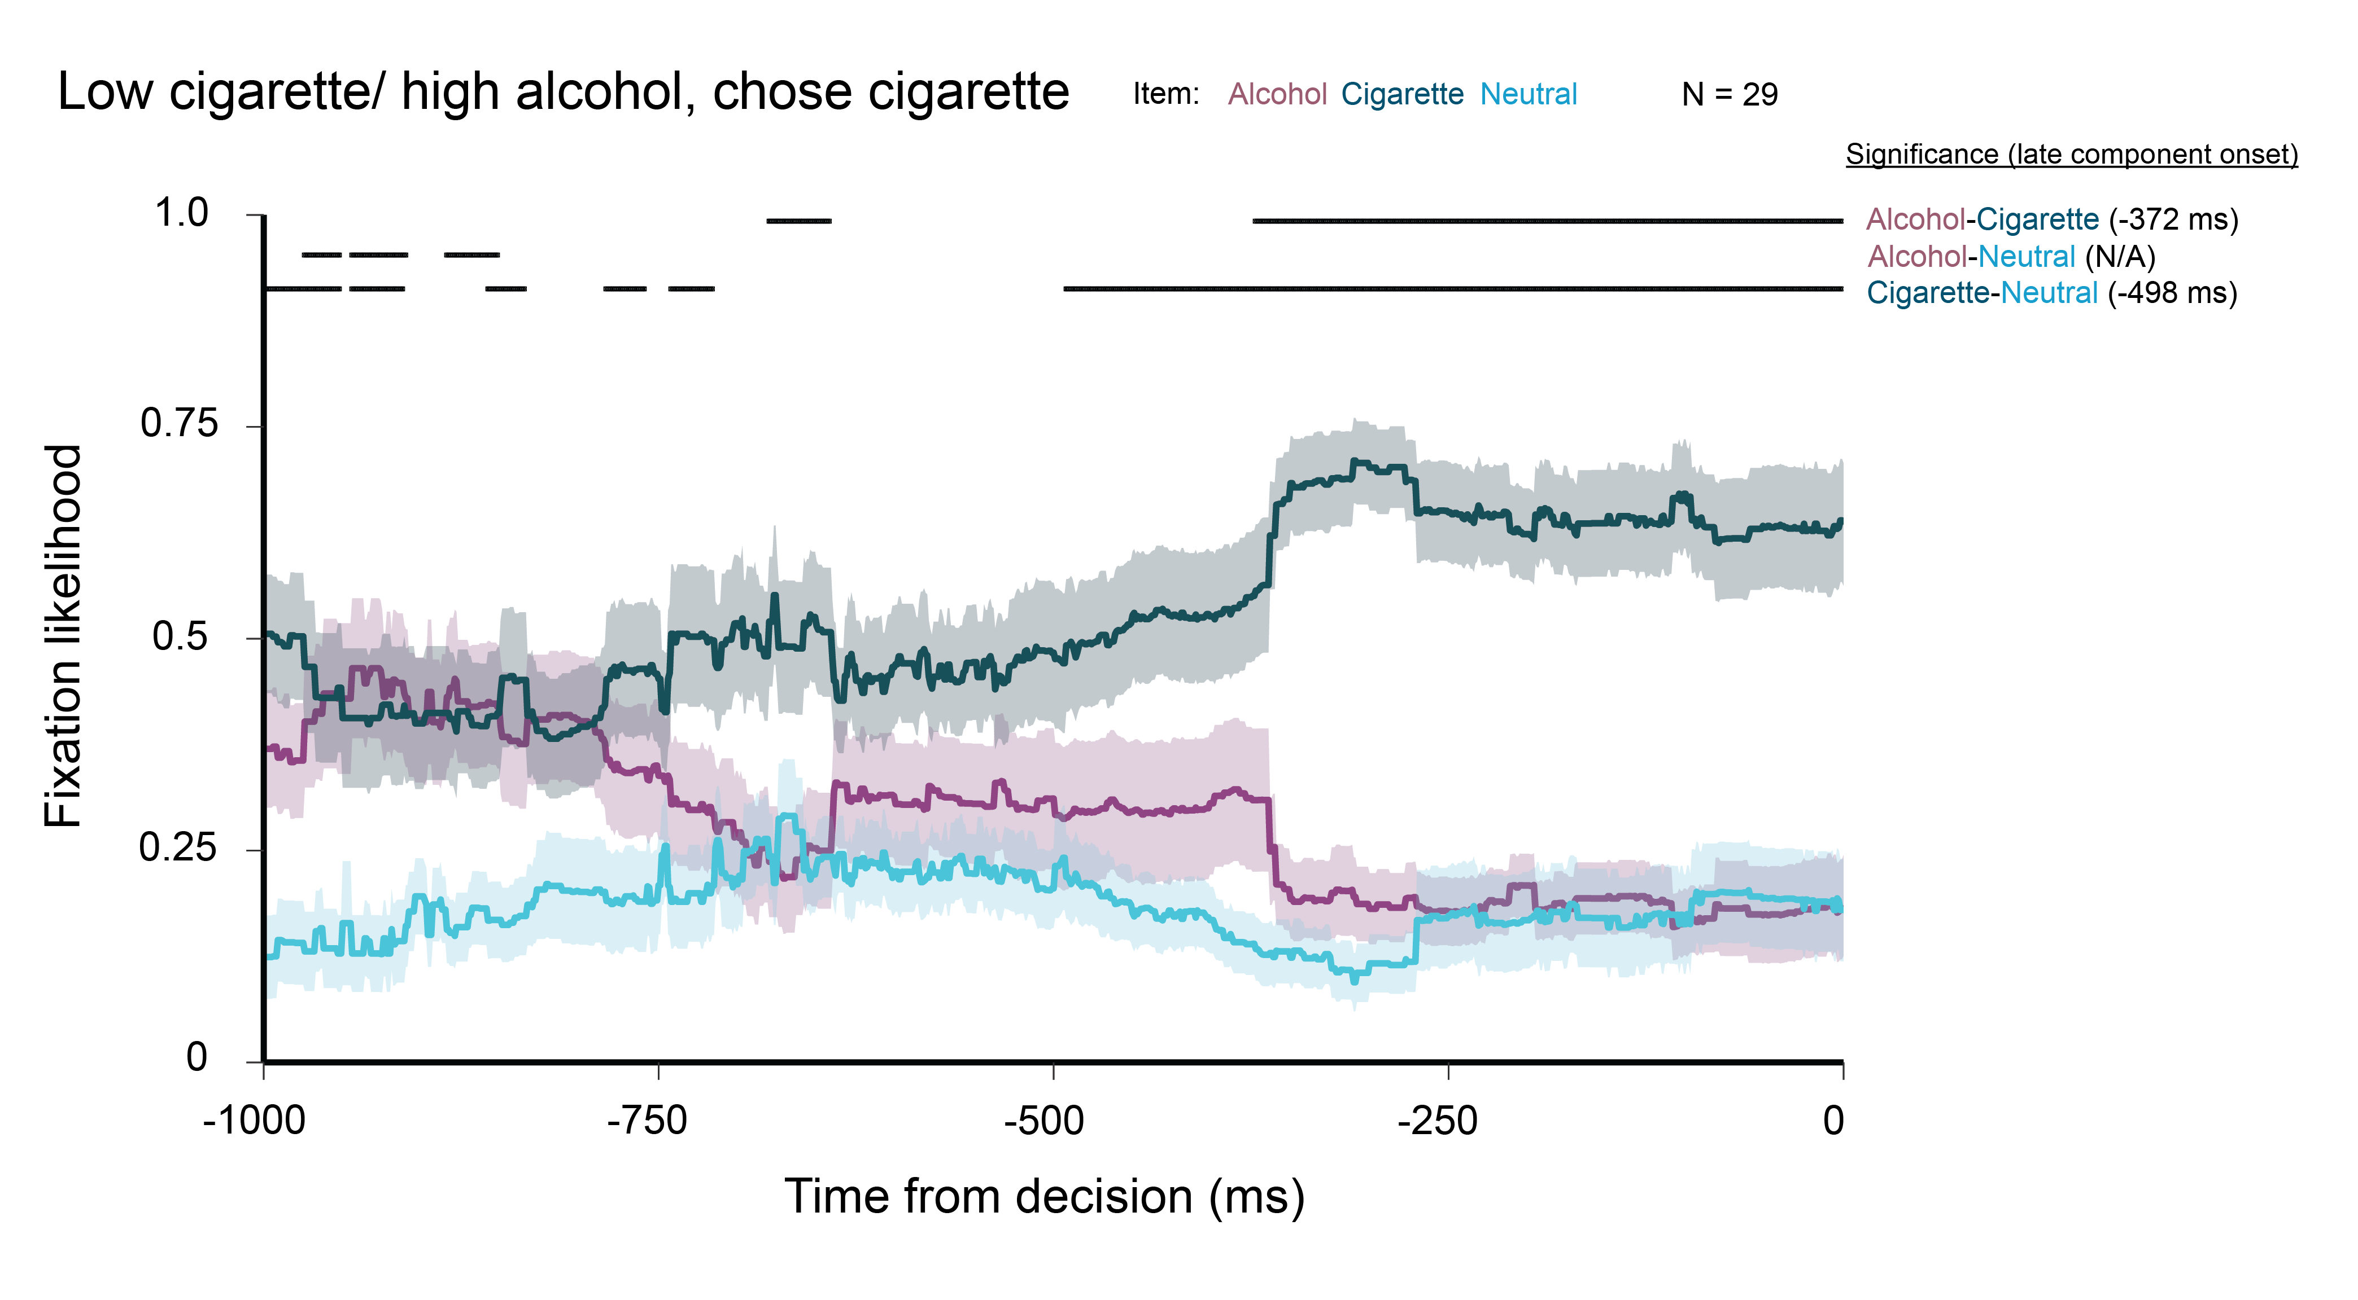
Notes:
Still looking at high preference alcohol later in the trial (compare to sampling behavior of the high cig/low alc condition, (parallel lines))

Slide 25
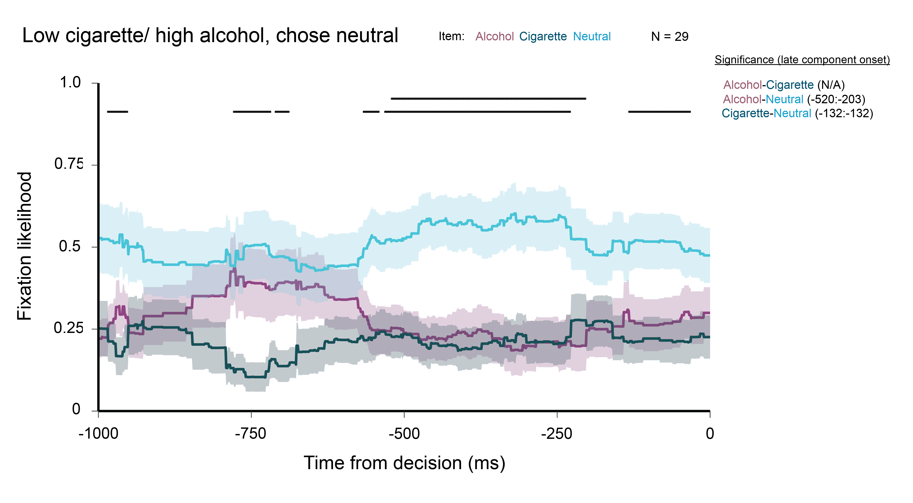
Notes:
Neutral not as indicative of which item preferred…

Slide 26
Key takeaways
High preference alcohol more strongly attracts gaze
Earlier onset of late component when selecting alcohol
When selecting cigarette, persistence of alcohol to attract gaze until late in trial
Gaze less predictive of neutral item choice
Decreased difference between neutral and addictive substances

Slide 27
Both low preference trials

Slide 28
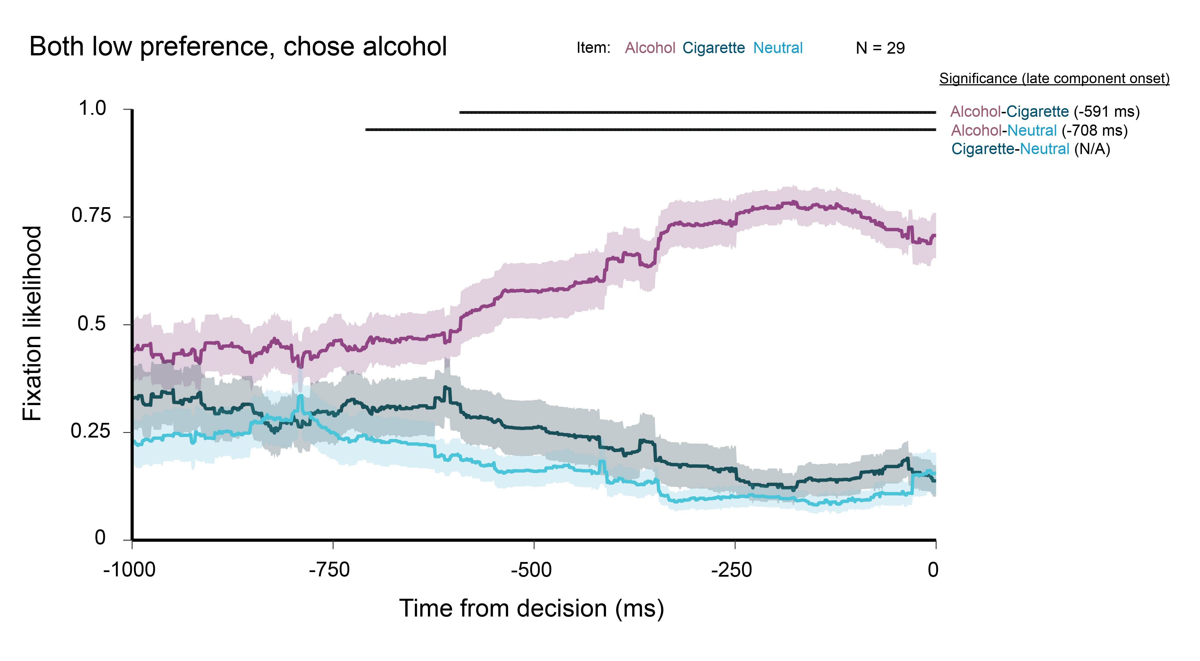

Slide 29
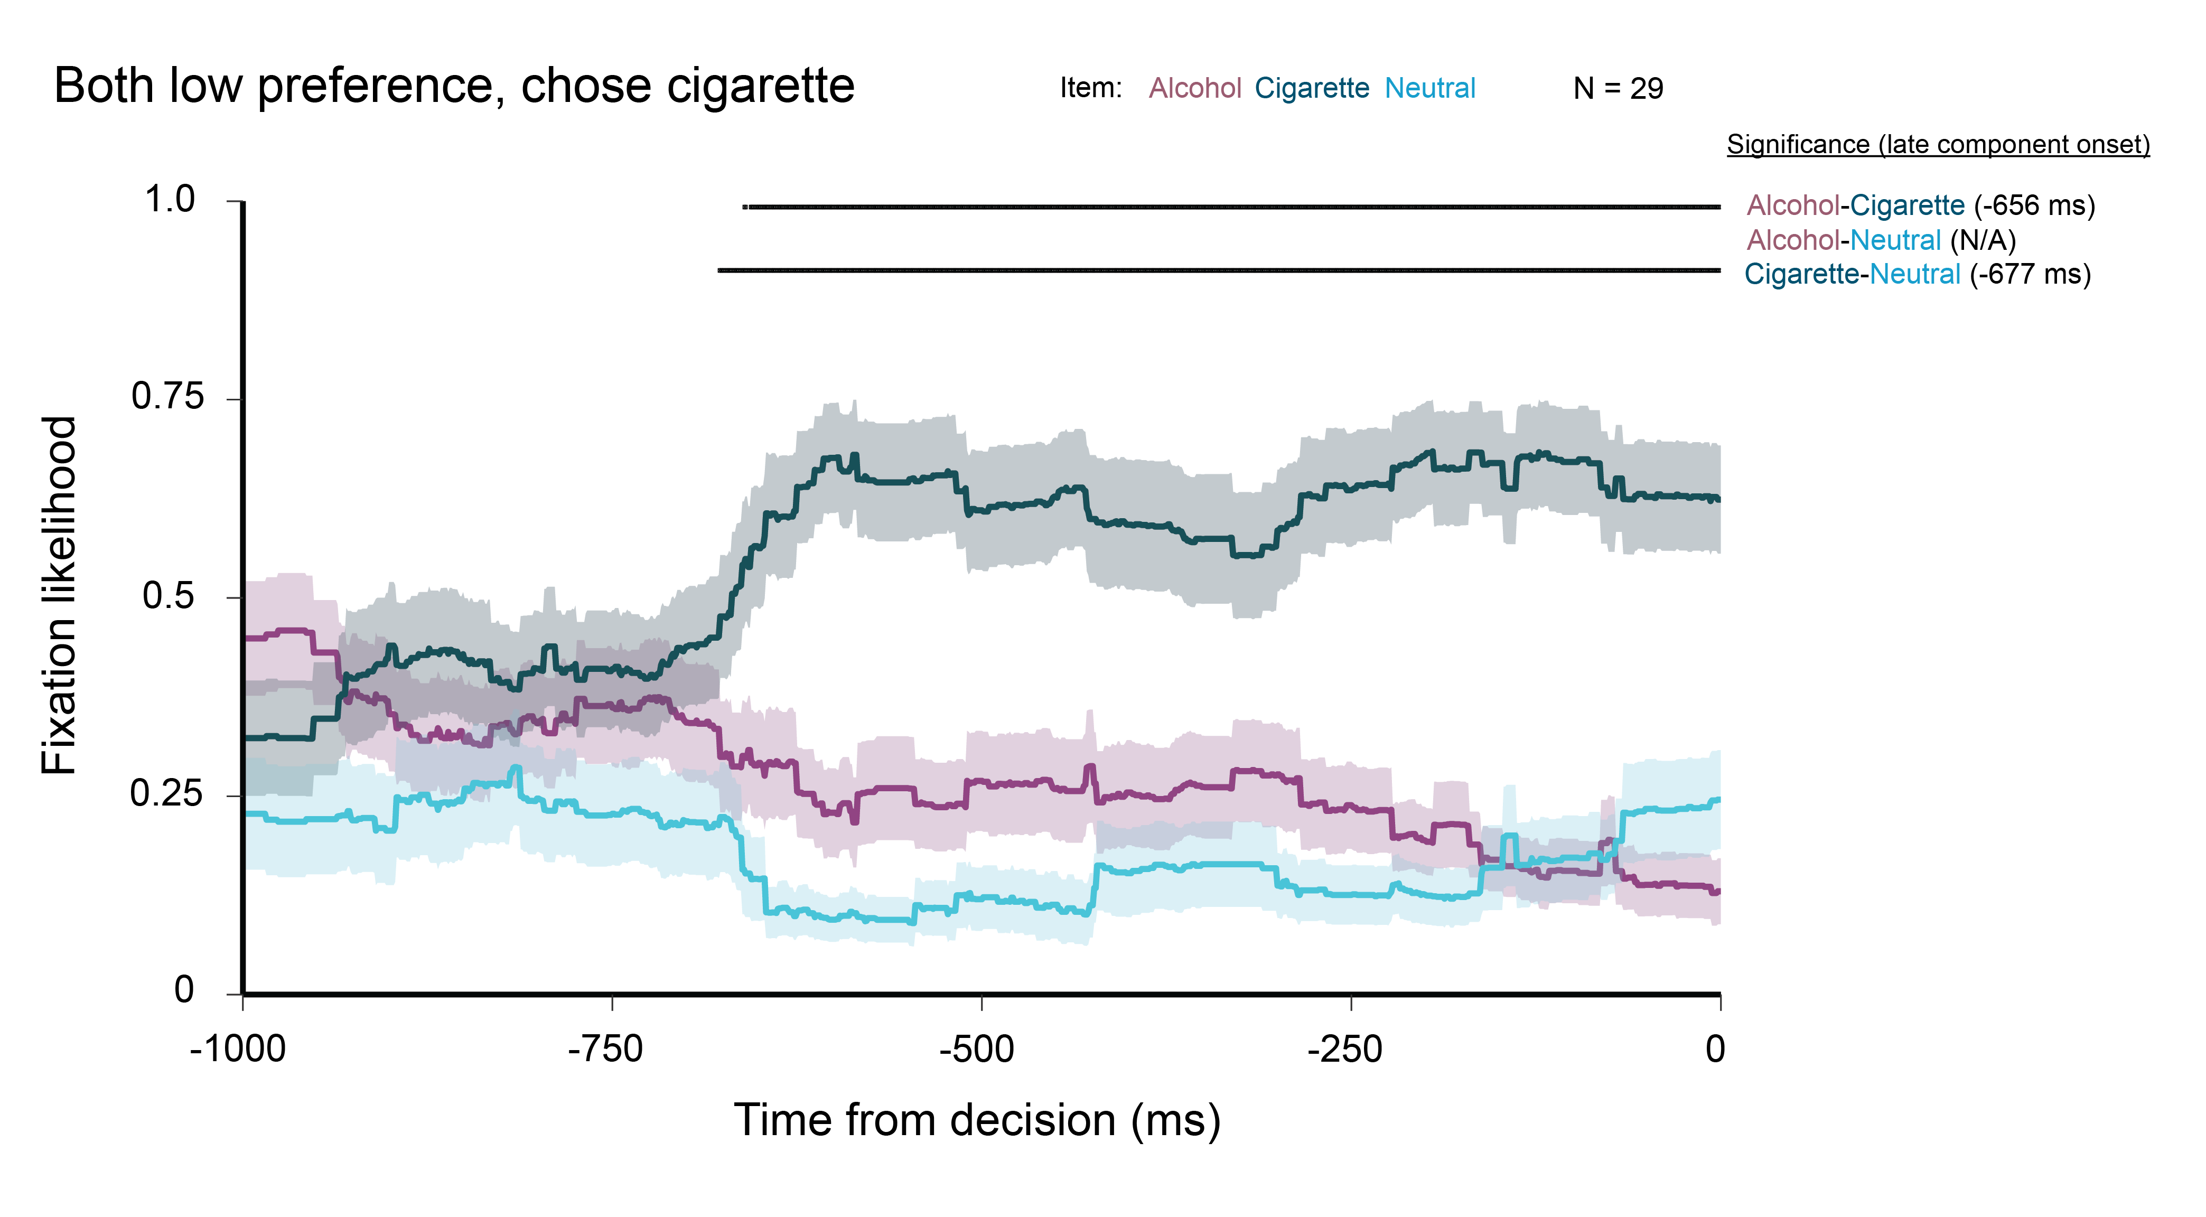
Notes:
More rapid ‘jump’ than when choosing alcohol… what does it mean?

Slide 30
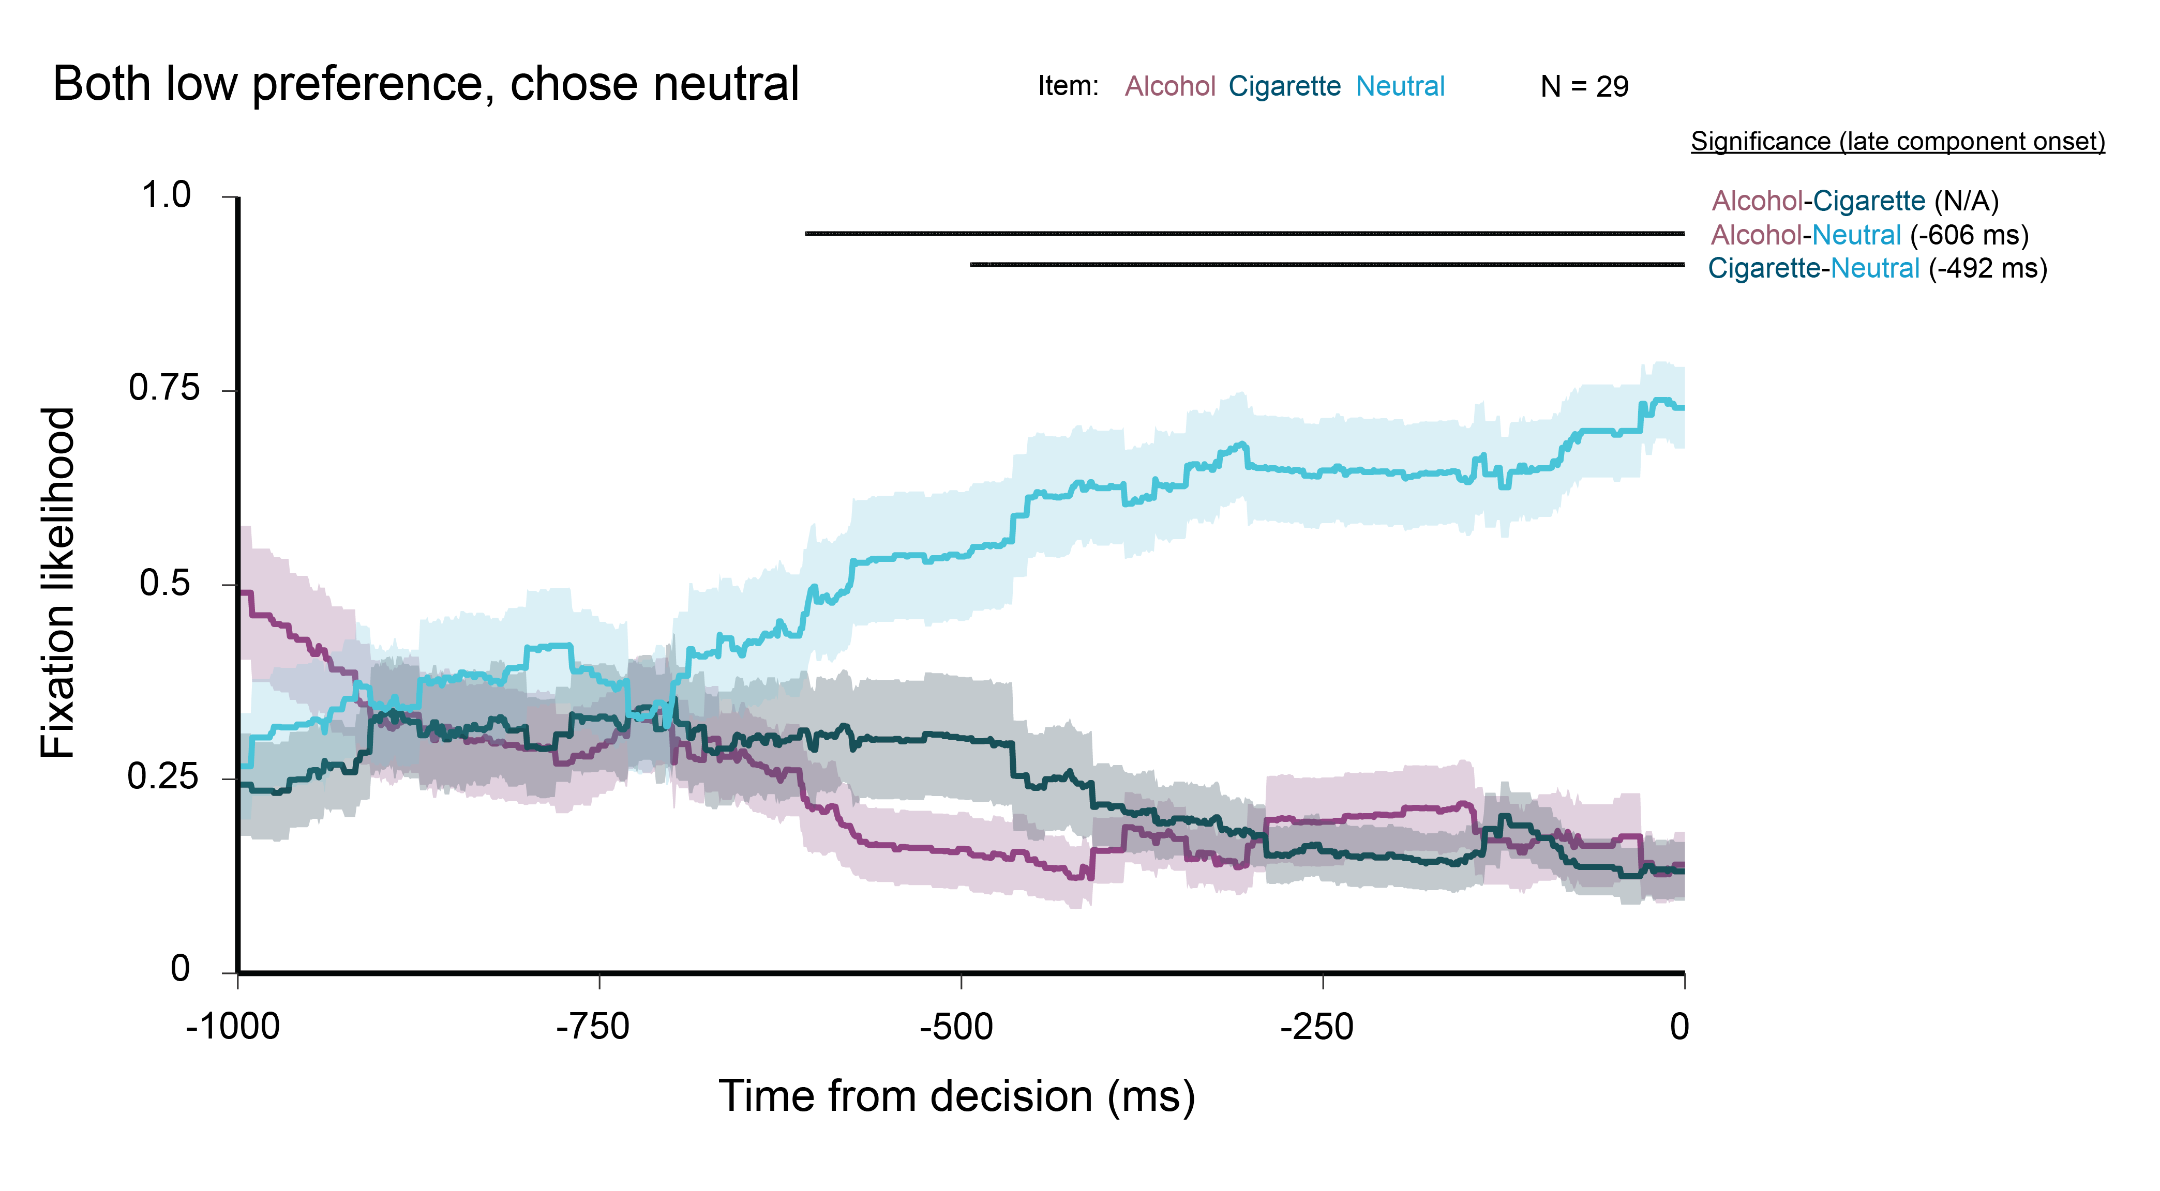

Slide 31
Key takeaways
Similar to both preferred substances trials
Late component onset ~ half way through a trial
When choosing cigarette, differentiates between items earlier than choosing alcohol (or neutral)

Slide 32
Overall conclusions
Gaze predictive of choice
Late component reveals higher likelihood of fixating chosen item
Onset of late component differs depending on value of items
Early onset for similarly valued items (both preferred and low preference trials)
Prioritization of gaze at alcohol during unequal values trials?
Low value alcohol -> Strong preference when chosen, early sampling when not
High value alcohol -> No sampling of cigarette when chosen, later onset significance of cig/alc comparison when cigarette chosen

Slide 33
Future questions
Are there individual differences in the predictability of choice by gaze?
Must take different modelling approach (multinomial logistic regression?)
Is the evolution of gaze predictive of cravings?
Incorporate subjective craving ratings from cue-reactivity session into model
Notes:
break down by choice, each trial type
start analysis at beginnig of trial
below, raw number of trials incorporated into the analysis to know what's up

